Slide 1

Unusual Buildings
Some Architects Must Have Been
One Toke Over the Line
Speakers on for Mexican Shuffle by
Herb Alpert and the Tijuana Brass
Click to Advance

Slide 2
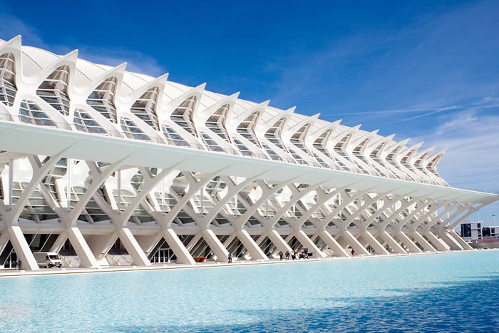
Valencia Spain Science Center

Slide 3
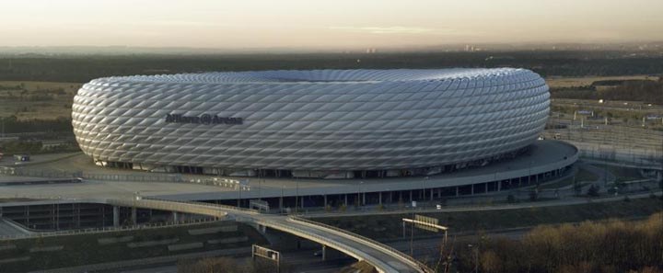
Allianz Arena, Munich, Germany

Slide 4
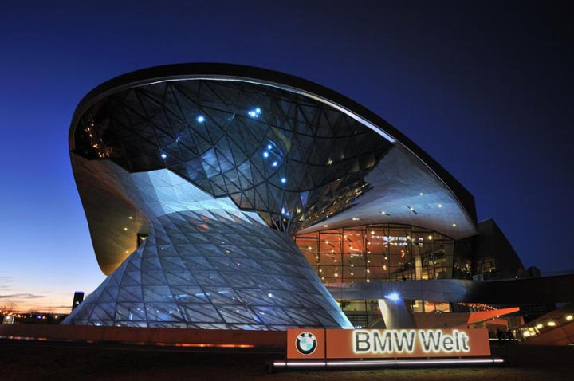
BMW World, Munich

Slide 5
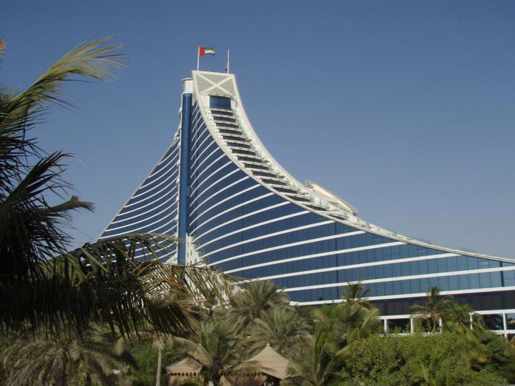
Jumeira Beach Residence Hotel, Dubai

Slide 6
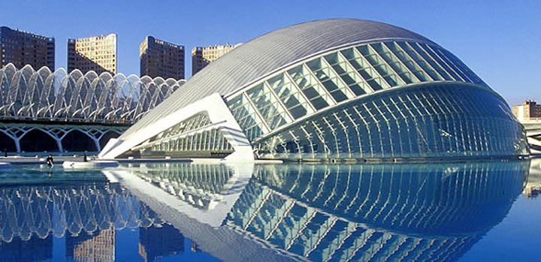
The Hemispheric, Valencia, Spain

Slide 7
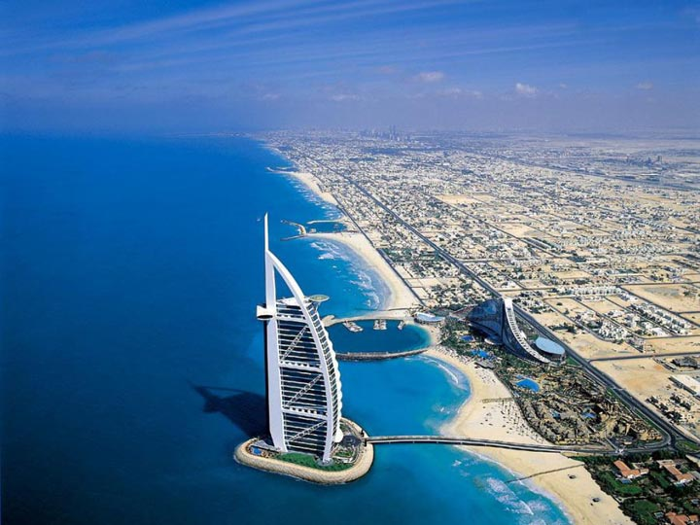
Burj Al Arab Hotel, Dubai

Slide 8
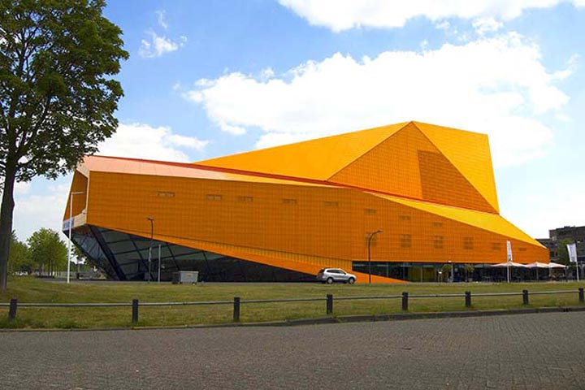
Agora Theater, Lelystad, Netherlands

Slide 9
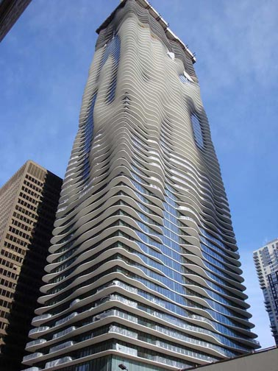
Aqua Building, Chicago, Illinois

Slide 10
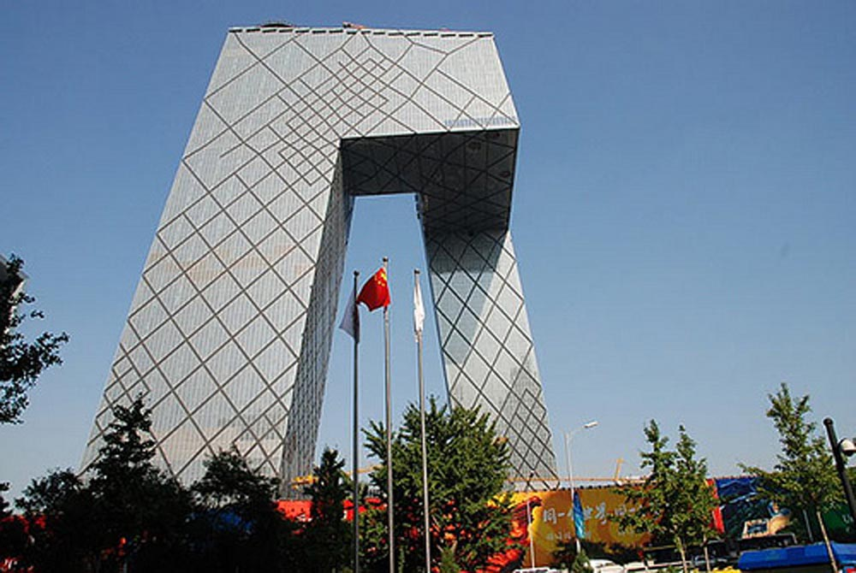
China Central Television Headquarters, Beijing, China

Slide 11
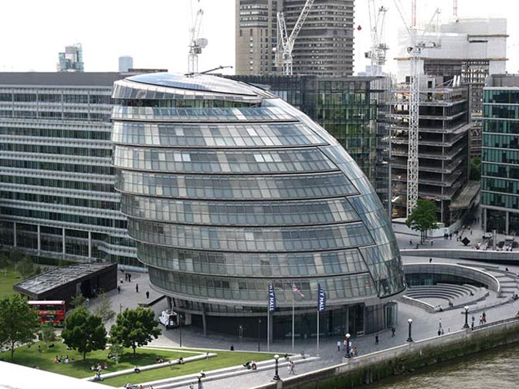
City Hall, London, England

Slide 12
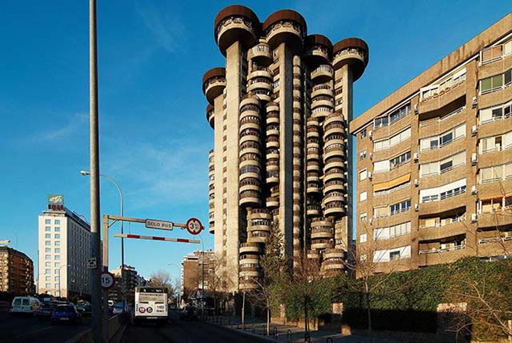
Edificio Torres Blancas, Madrid, Spain

Slide 13
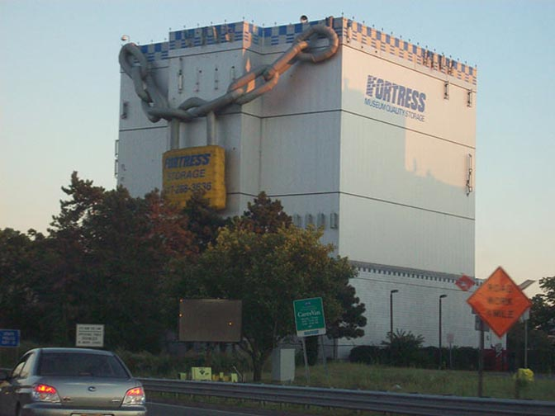
Fortress Storage, Boston, Massachusetts

Slide 14
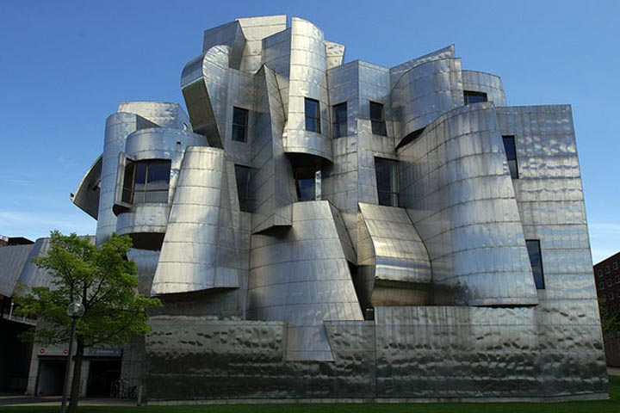
Frederick R. Weisman Art Museum, Minneapolis, Minnesota

Slide 15
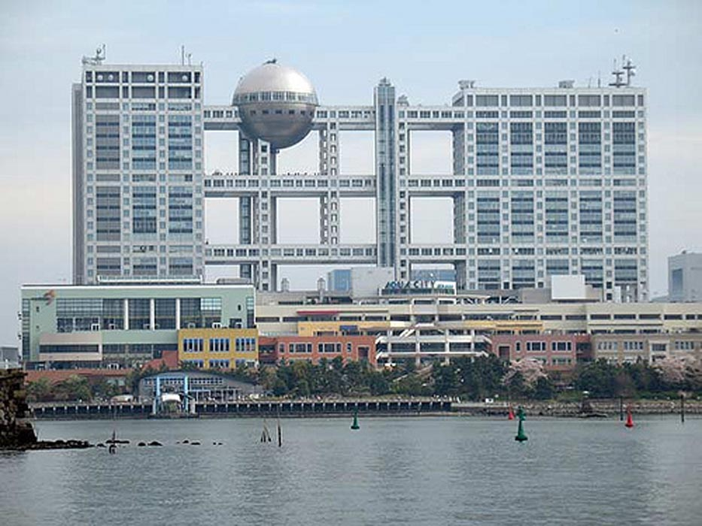
Fuji Television Building, Tokyo, Japan

Slide 16
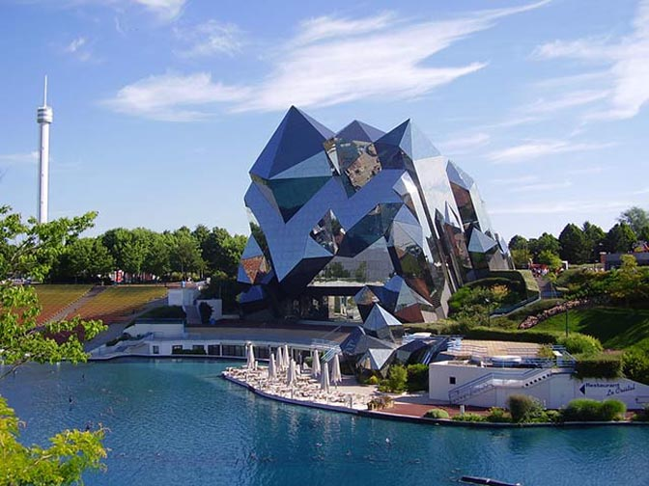
Futuroscope, Poitiers, France

Slide 17
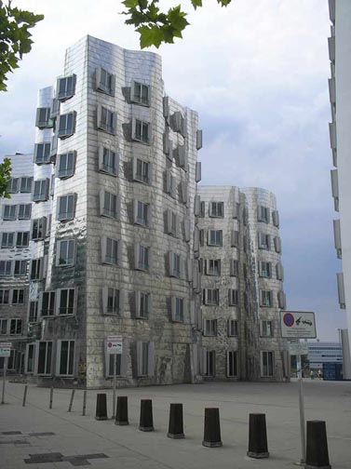
Gehry Building, Dusseldorf, Germany

Slide 18
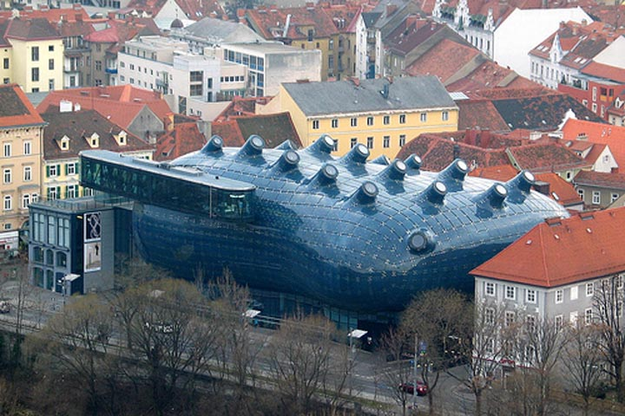
Graz Art Museum, Graz, Austria

Slide 19
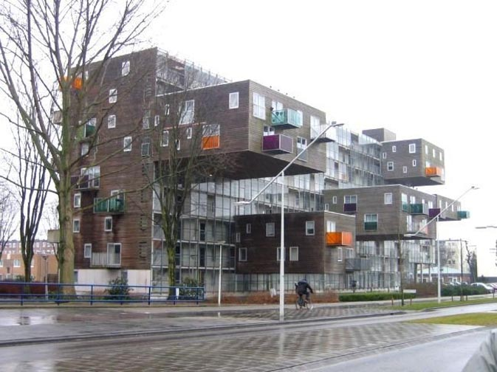
Apartments in Holland

Slide 20
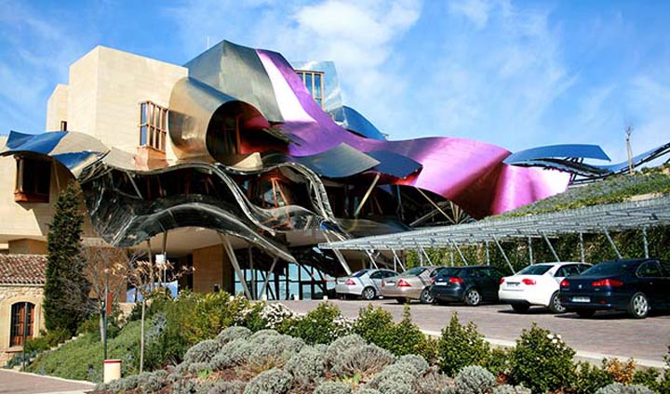
Hotel Marques De Riscal
Elciego, Spain

Slide 21
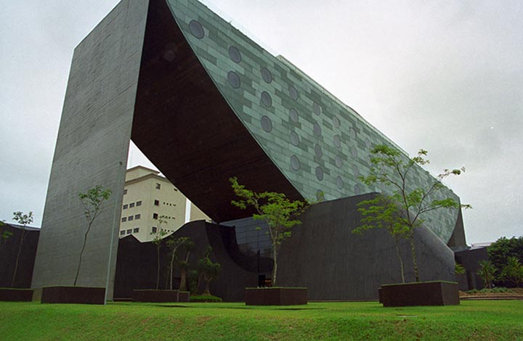
Hotel Unique, Sao Paulo, Brazil

Slide 22
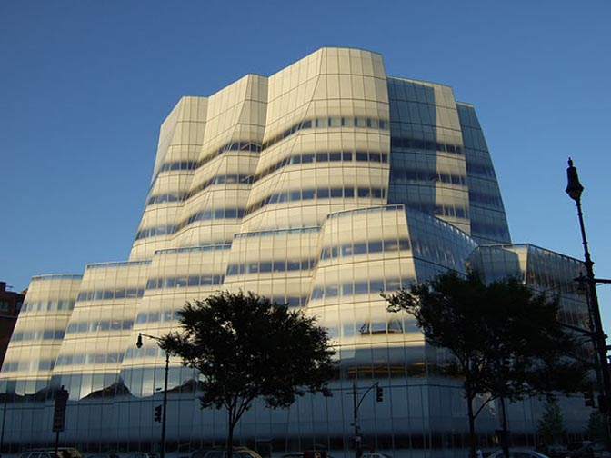
IAC Blues, New York, NY

Slide 23
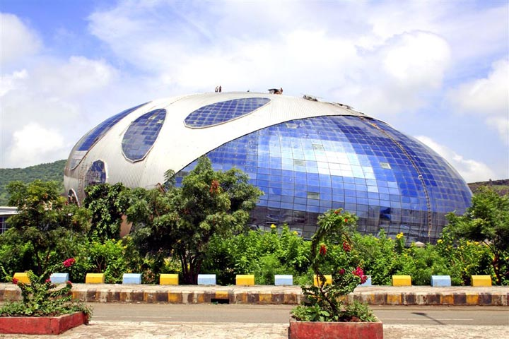
Infosys Building, India

Slide 24
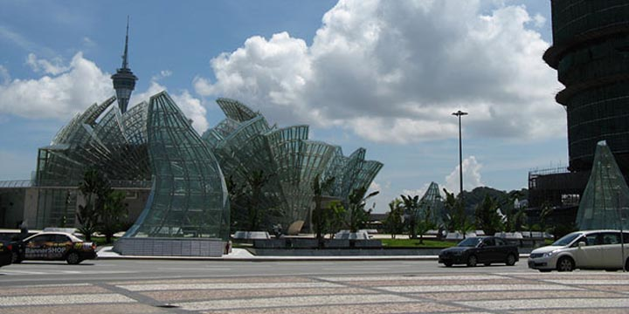
Macau, China

Slide 25
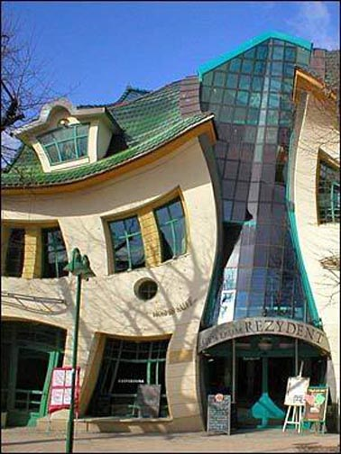
Sopot, Poland

Slide 26
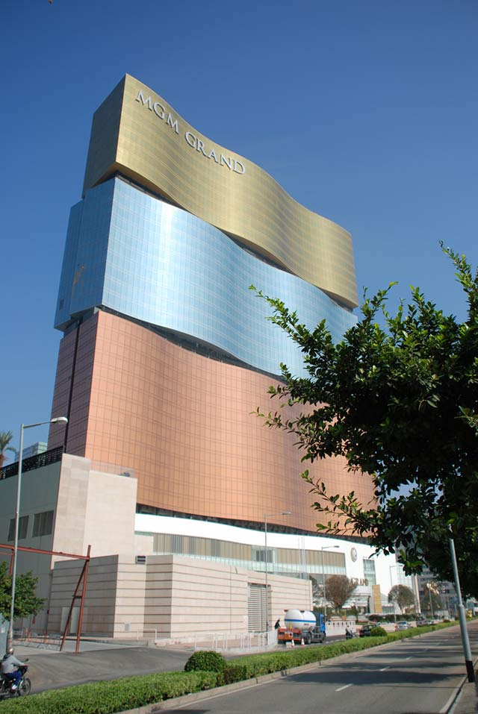
MGM Grand, Macau, China

Slide 27
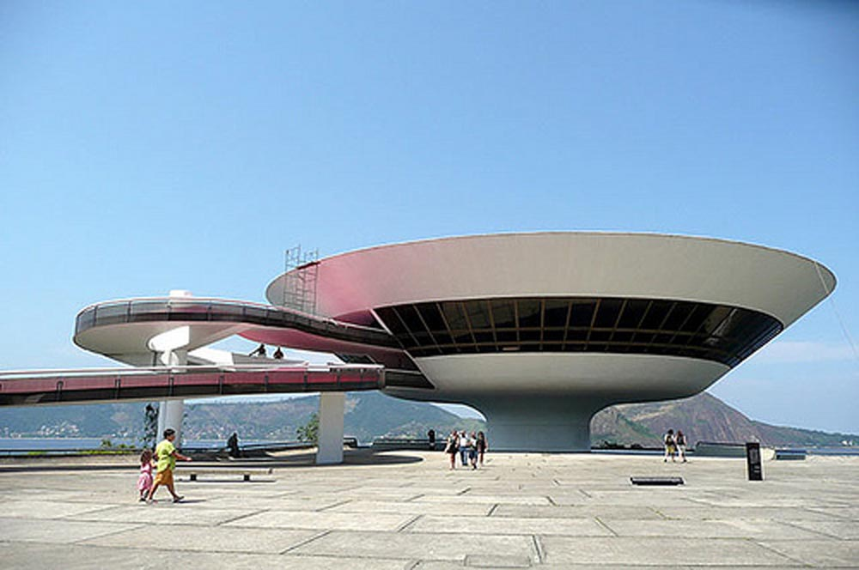
Museum of Contemporary Art, Niteroi, Brazil

Slide 28
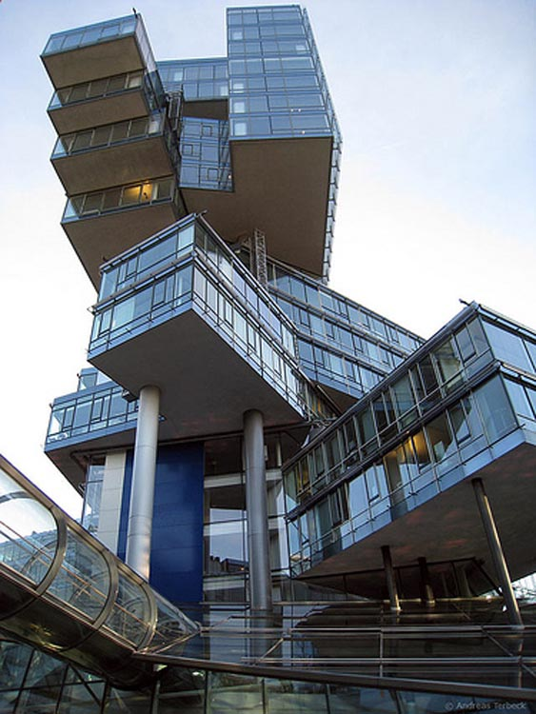
Nord LB Building Hannover Germany

Slide 29
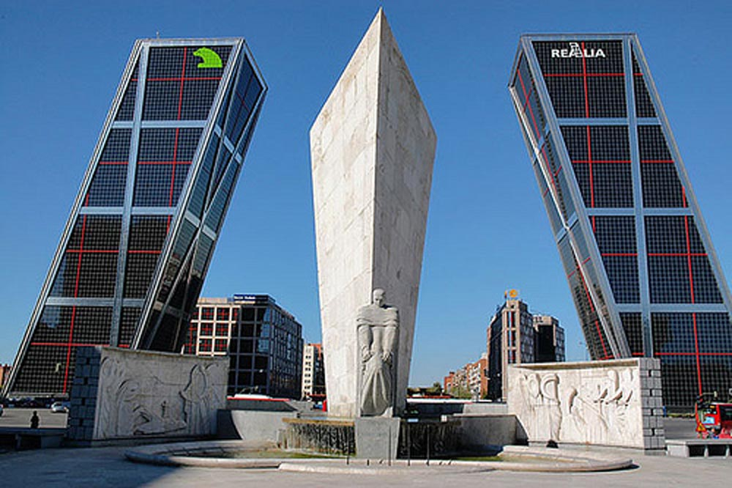
Puerta de Europa Towers, Madrid, Spain

Slide 30
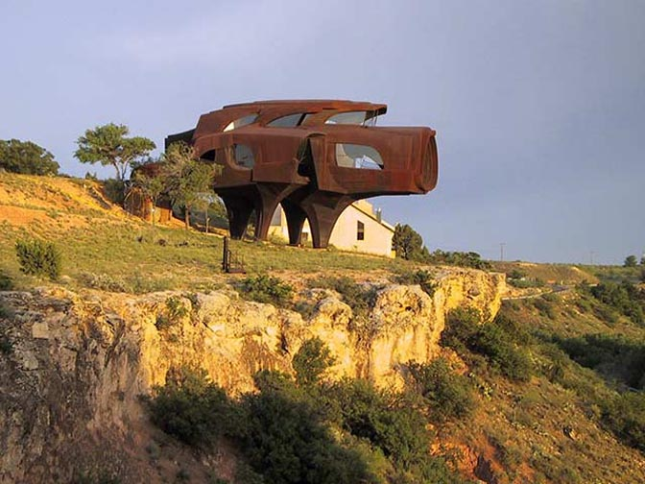
Robert Bruno's House, Lubbock, Texas

Slide 31
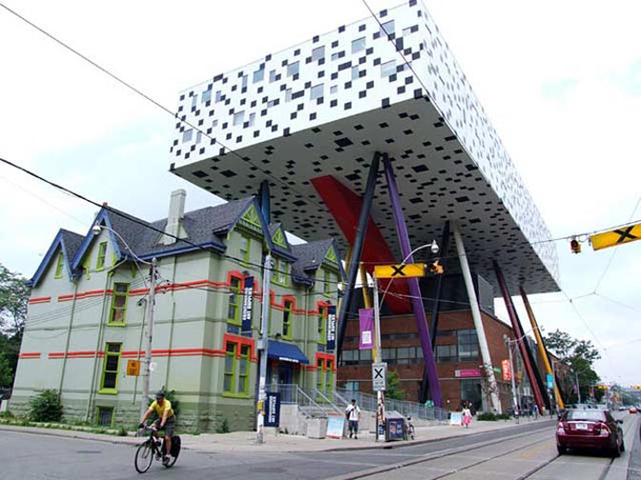
School of Design OCAD Building, Toronto, Canada

Slide 32
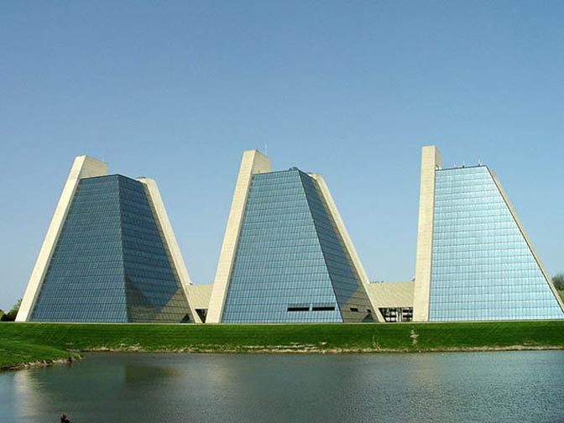
The Pyramids, Indianapolis, Indiana

